Slide 1
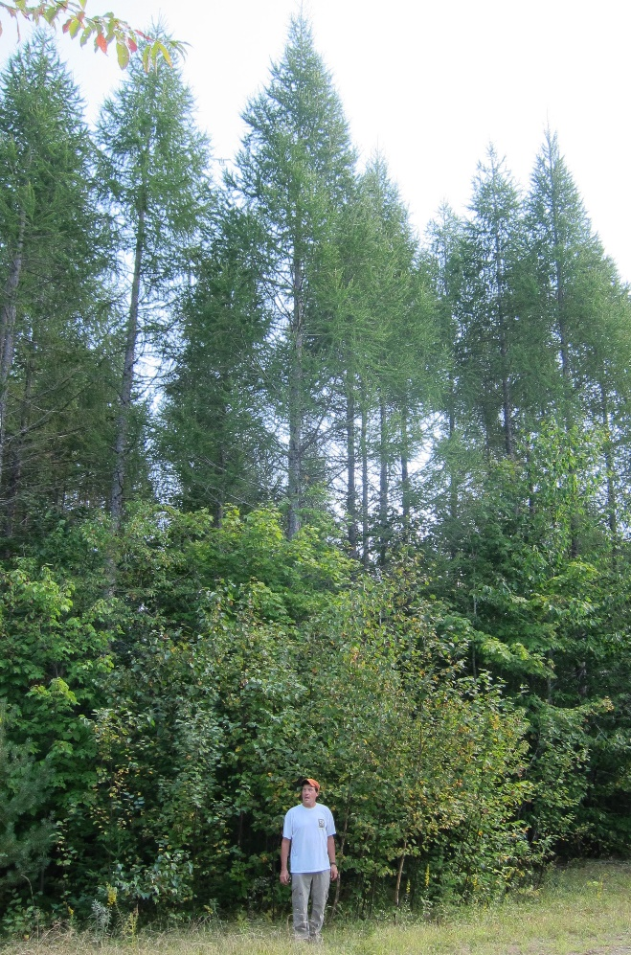
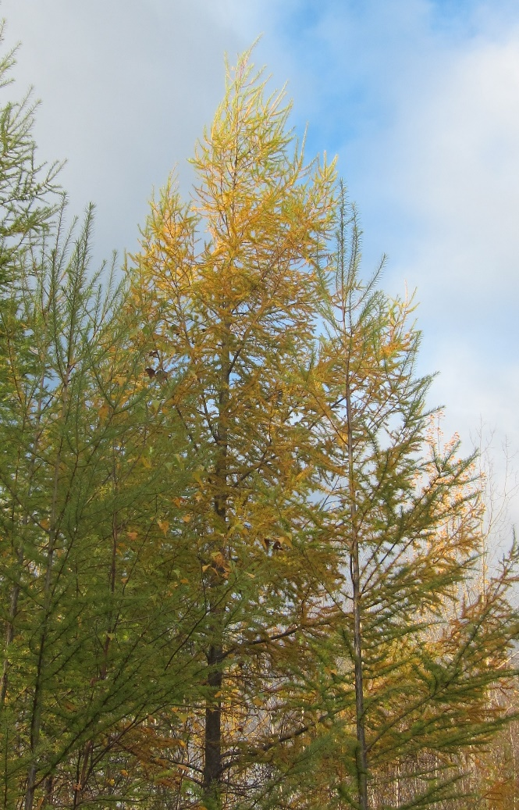
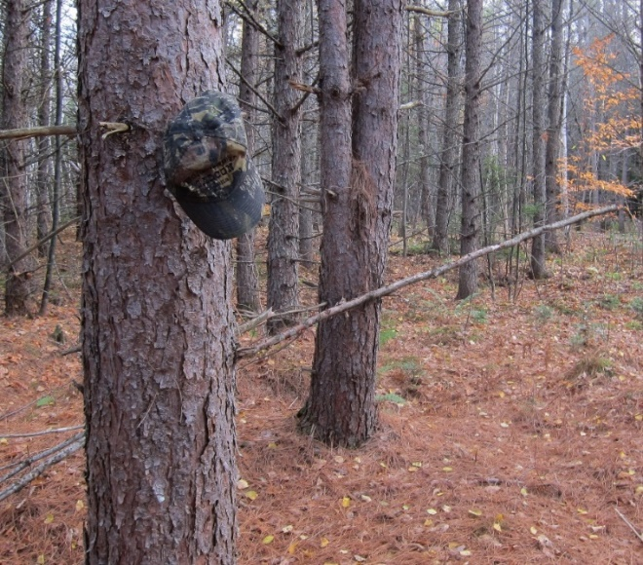
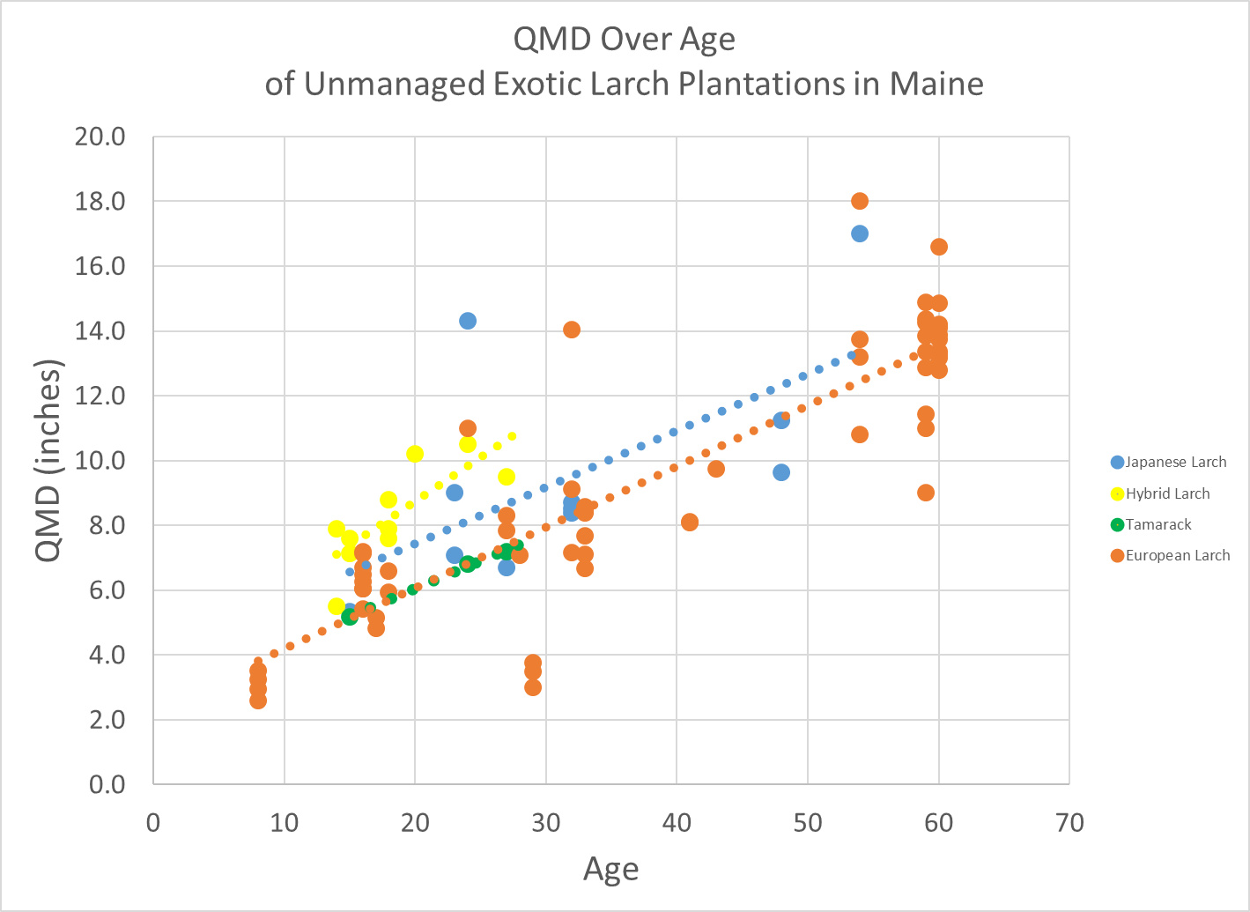
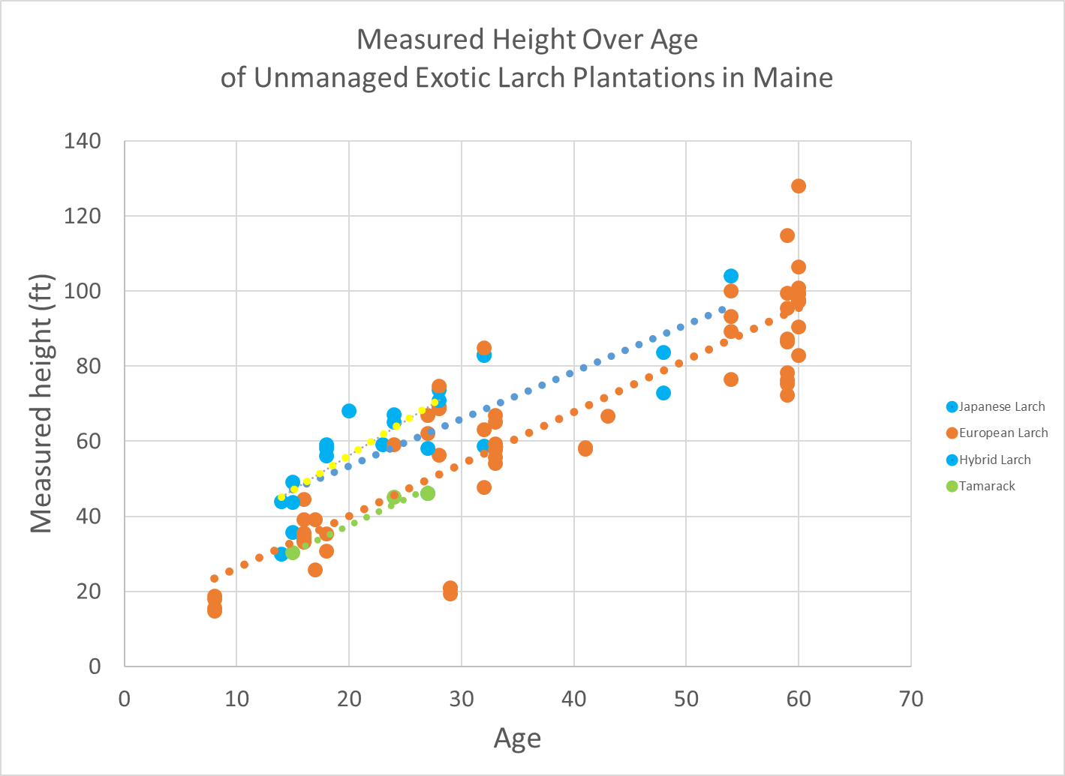
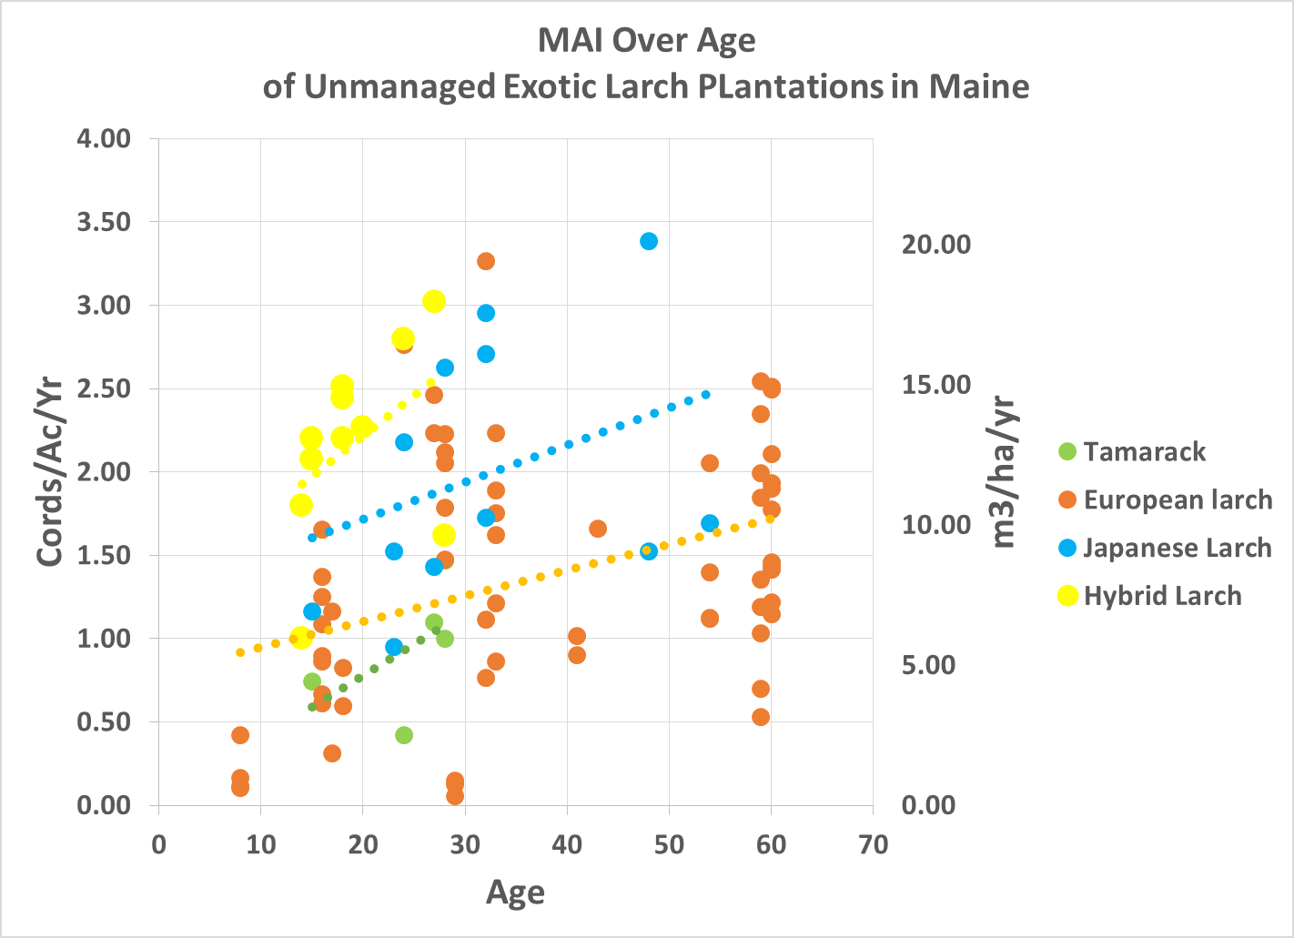
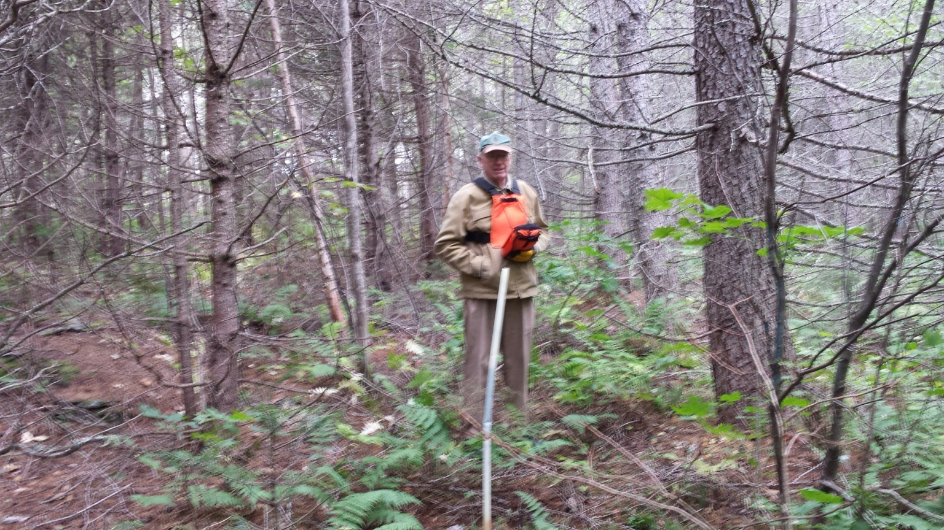
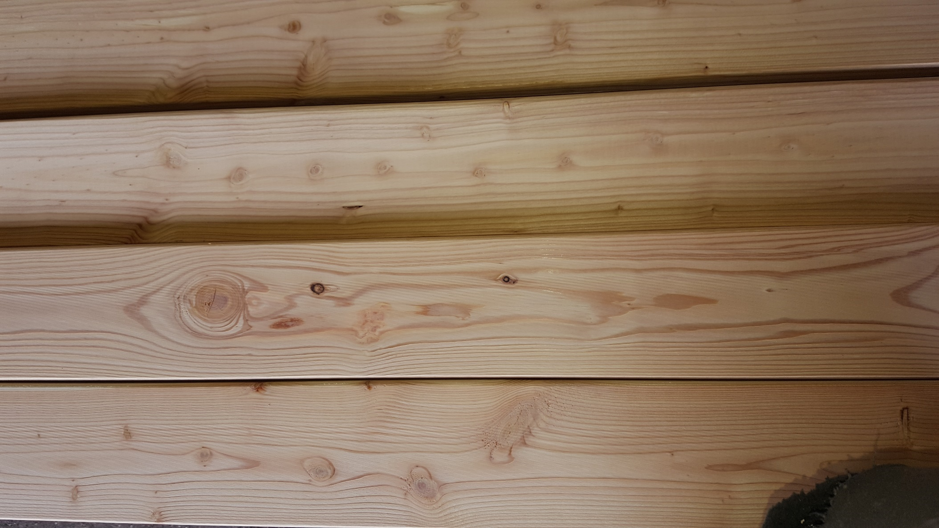
Smoky Gold: Fast-Growing Larch Plantations in Maine
D. I. Maass¹, L. C. Irland², B. E. Roth³
(1) Independent Consultant, Portland, ME
(2) Consultant, Wayne, ME
(3) University of Maine, School of Forest Resources, Orono, ME
ABSTRACT
MATERIALS and METHODS
Current observations do not suggest any pest risks that are higher than other species now being planted. The exotics have been seen to reproduce naturally in disturbed areas near the plantations, but if this is seen as a problem it is readily managed.
CONCLUSIONS
Aldo Leopold’s famous essay notes the farmers planting larch in Central Wisconsin to bring back the species, with its ‘smoky gold” fall foliage.
Since then, around the Northeast, exotic and hybrid larches (Larix X marschlensii ) have been planted by a variety of agencies and landowners. This poster is based on measurements of 56 stands in Maine. Early growth results for Maine plantings have been previously reported, with growth rates of one cord/ac/yr and more.
The number of re-measured stands and the range of ages yields far higher confidence in yield results than existed 30 years ago for native species.
Economic analysis shows financial returns at least as favorable as other species currently being planted regionally. More complete yield models, and comparisons with commonly planted red pine and white spruce are in preparation. Concerns for damaging agents and invasiveness are discussed.
The widely held perception that “there is no market” is incorrect.
The data was derived as part of a larger study designed to evaluate yields of various planted species on different soil types. Methods and data are described elsewhere in material on the www.larchresearch.com website.
Basal area and quadratic mean diameters (QMD) were calculated. Volumes were calculated at age 10, 16 and 27 using taper equations published by Li et al. (2012). Total volume was calculated without any limiting top diameter. Merchantable volumes were calculated based on diameters and heights at age 16. Total merchantable volume was calculated to a 3” (7.6 cm) top diameter and total sawlog merchantable volume was calculated to 8” (20.3 cm) top diameter.
Native tamarack planted on upland sites and given modest site preparation, grows very well. Good news for anyone wanting to use a native species to add some Smoky Gold on their property.
Risks commonly cited include vulnerability to snow damage, and porcupines. In our own visits, though, these have not been observed. It is not known whether periodic larch sawfly outbreaks will affect the exotics and hybrids.
Data on re-measured stands shows that larch growth rates are very high.
Ages span a wide range, from age 15 to almost 60 yr.
Hybrid larch height growth is consistently and statistically greater than that of either of their Japanese and European parents.
Volume yields are high, with large proportions of wood meeting minimum sawlog sizes at age 16.
Return on investment on an incremental basis is attractive. Timber growing landowners as well as woodlot owners would find returns attractive. But an investor seeking to buy land, plant, and sell at age 16 would not. We know of no species in Maine that would meet that test.
Planting tamarack on upland sites could be attractive to owners with nonfinancial goals.
There are strong reasons to believe that active management would yield dramatic improvements.
ECONOMICS AND MARKETS
Re-measurement data show that growth performance is very strong. Since we cannot foresee markets and prices, we adopt the following utilization/price assumptions, using them with no future escalation. Larch offers a merchantable yield at age 16. By age 16, there is no commercially valuable yield for white spruce, only the cost of a forthcoming PCT. For red pine there will probably be pulp, but whether a pulp thinning could earn positive net returns is uncertain. Even at age 27, white spruce, widely planted in Maine, yields only pulpwood. A timber growing entity or small landowner will, no doubt, be attracted by the prospect of small sawlogs in far less time by planting exotic larch rather than species they are already planting.
OBJECTIVES
REFERENCES
To use re-measured existing stands to examine the economics of growing larches under current conditions. It has long been observed that larches, both exotic and hybrid, perform extraordinarily well in height and diameter growth. Yet little formal documentation on planted larches exists. This poster reports summary for 56 remeasured stands in Maine ranging in ages from 15 to 54 years.
Baltunis, B.S., M.S. Greenwood, and T. Eysteinsson 1998. Hybrid vigor in Larix: growth of intra- and interspecific hybrids of Larix decidua, L. laricina, and L. kaempferi after 5 years. Silvae genetica. 47: 288-293.
Carter, K.K. and O. Selin, 1987. Larch plantation management in the Northeast. NJAF 4 : 18-20.
Carter, K.K. and D. I. Maass. 1991. A forester’s guide to larch in Eastern North America: an annotated bibliography. University of Maine, CFRU Info. Report 24. 47 pp.
Gerlach, John. P. 2001. Comparison of productivity and related traits for European larch and red pine across a site quality gradient in the Great Lakes Region. MS thesis submitted to Michigan state University. 114 pp.
Gilmore, D.W. and R., D Briggs. 1996. Empirical yield prediction equations for plantation-grown European larch in Maine. NJAF 13(1):37-40.
Greenwood, M. S., B. E. Roth, D. Maass and L. C. Irland. 2015. Near rotation-length performance of selected hybrid larch in Central Maine, U.S.A. Silvae Genetica 64(1-2):73-80.
Johanson, T. 2012. Site index curves for young hybrid larch growing in former farmland in southern Sweden. Forests 3: 723-735 (2012).
Larsson-Stern, M. Larch in Commercial Forestry: A Literature Review to Help Clarify the Potential of Hybrid Larch (Larix × eurolepis Henry) in Southern Sweden. Southern Swedish Forest Research Centre Alnarp, Sweden. 34pp.
Li, R., Weiskittel, A.R., Kershaw Jr, J.A., Dick, A., Seymour, R.S. 2012. Regional stem taper equations for eleven conifer species in the Acadian Region of North America: Development and assessment. Northern Journal of Applied Forestry 29, 5-14.
Maass, D. Exotic Larch: Not Your Grandfather’s Hackmatack. Northern Woodlands, Summer 2014.
Sander, H. and A. Läänelaid. 2007. The Dunkeld larch (Larix × marschlinsii Coaz) in Estonia. Dendrobiology 57:73-80.
Michael B. Walters and John P. Gerlach, 2013. Intraspecific growth and functional leaf trait responses to natural soil resource gradients for conifer species with contrasting leaf habit Tree Physiology 33, 297–310.
Markets for larch vary. Maine larch has been processed into lumber of very high quality, but only one mill is known to have done this. Plantations are being cut at young ages for pulpwood. There is no bulk market, which in fact suits the situation since supply at present is so limited. In other states, larch logs have sold for white [pine prices; in Maine, hemlock prices are more likely. Larch lumber will be a short production run specialty for some time to come. Ut its rapid growth can compensate for low stumpage prices.
Average diameters of larch plantations by age
Average heights of larch plantations by age
Black spruce on left and hybrid larch on right at age 27 years.
ACKNOWLEDGEMENTS
Larch lumber sawn in Maine
The authors acknowledge Carl Haag for his work in establishing the Chase Stream and other research plots. Also the many landowners for permitting remeasurement visits.
Contact: Lloyd Irland, (207) 685-9613, lcirland@gmail.com
Average volume per acre of larch plantations by age

